Slide 1

SRM INSTITUTE OF SCIENCE AND TECHNOLOGY
COLLEGE OF ENGINEERING AND TECHNOLOGY
DEPARTMENT OF NETWORKING AND COMMUNICATIONS
18CSP109L/18CSP111L MAJOR PROJECT
SMS Spam Detection using Natural Language Processing and Ensemble Learning
Student 1 Reg No : RA1911030010100
Student 2 Reg No : RA1911030010071
Batch ID: NWC071110
Guide name and Designation : Dr. C. Fancy
Assistant Professor

Slide 2
Table of Contents
Abstract
Introduction
Motivation
Literature Survey
Challenges and limitations in existing system
Objectives of the project
Innovation Idea
Scope and application of the project
Architecture
Proposed Modules and their descriptions

Slide 3
Abstract
SMS Spam is sent by scammers trying to phish on people, also called Smishing (SMS phishing) where they send a message to the victim saying that they have won something and want the victim to click on a malicious link to steal data or access the victim’s device. By creating multiple models for spam detection and combining the best performing models using ensemble learning techniques would give us a model which would predict a text message from spam and legitimate with much more accuracy. The model will be pipelined into a website using streamlit and railway hosting platform.

Slide 4
Introduction
Ensemble learning is a type of learning in AI/ML where multiple different models are used and then their different outputs are combined to give a final result.
By using the concept of ensemble learning, we can train multiple models and choose the ones with very high accuracy and precision and use those models together to get a model which gives a more accurate prediction.

Slide 5
Motivation
Everyone gets annoyed when they receive spam text messages from time to time and clutter chat logs on messaging app. Sometimes people even fall for spam texts thinking they are legitimate and less educated and senior citizens are much more prone to this. By determining if a message is spam, the user can ignore and delete the message and prevent less educated and senior citizens to fall for scams.

Slide 6
Literature Survey
S. No. | Name | Techniques Discussed | Conclusion | Parameters Discussed | Limitations
1 | Spam Detection in SMS Based on Feature Selection Techniques(2019) | Chi-square, feature gain for feature extraction. | Naive Bayes model was improved. | Uses F1 score as a metric. | The improvement was very insignificant when Chi-square and feature gain were used
2 | A deep learning method for automatic SMS spam classification: Performance of learning algorithms on indigenous dataset(2022) | Used Tf-idf, Neural Networks, LSTM. | Using BiLSTM model instead of LSTM increased little performance. | BiLSTM model | This model was very expensive and insignificant increase in performance.
3 | Transformers: State-of-the-art natural language processing(2020) | Talked about the importance on transformers. | Tf-Idf transformer is best option for vectorizing the dataset. | Sentencepiece, Wordpiece,Unigram | Other vectorizers may perform better in different models.

Slide 7
Literature Survey
S. No. | Name | Techniques Discussed | Conclusion | Parameters Discussed | Limitations
4 | Spam Email Detection Using Deep Learning Techniques(2021) | LSTM with AdamW optimizer | Bert base case model gave highest accuracy | Dense and Dropout layers in model | Insignificant accuracy increase but huge computation load
5 | The effects of natural language processing on big data analysis: Sentiment analysis case study(2018) | Hadoop and MapReduce | Naive Bayes model gaive 74% accuracy after using MapReduce | Giving weights to nouns, verbs and prepositions. | MapReduce gave the model a very low accuracy.
6 | A Spam Transformer Model for SMS Spam Detection(2020) | Recurrent Neural Network, Seqence2Sequence model,Tf-Idf, GloVe | Using the Tf-Idf transformer give some modification gives higher accuracy model | Transformers, Hyperparameter Tuning. | The accuracy of the model can be improved using other algorithms

Slide 8
Literature Survey
S. No. | Name | Techniques Discussed | Conclusion | Parameters Discussed | Limitations
7 | Spam detection on social networks using cost-sensitive feature selection and ensemble-based regularized deep neural networks(2020) | Using ensemble learning on RDNN models | Ensemble learning increased accuracy of the new model. | Bagging, Boosting | Dataset was tested on twitter posts and not tested on text messages.

Slide 9
Challenges and Limitations
While combining the multiple models, we will need to choose the ones such that the accuracy does not decrease with keeping the precision of the model as high as possible as well. And even after creating the model, the model would still need constant training on new dataset including data generated and classified by the user themselves.

Slide 10
Objectives of the project
The main goal of this project is to create an ensemble model with higher accuracy than its base models without losing precision of the model. Using the models that give 100% precision, we would take them as base models such that the final model can classify text messages as accurately as it can while avoiding false negatives.

Slide 11
Innovation
The SMS spam detection models that have been previously created have not been created using ensemble learning techniques, i.e. current models have only been used creating Naive Bayes algorithm. The innovation in this project is to create multiple models based on different algorithms and combing the best performing models while increasing the accuracy of the model.

Slide 12
Scope and Application
The dataset will be preprocessed and features will be extracted such as number of words, letters and sentences. The words of texts will be stemmed and removing the stopwords after which the dataset will be trained on different Naive Bayes variants and the best performing model will be selected as the base models and other models including Random Forest, K nearest neighbors and more will be tested and the best performing models will be selected for the ensemble model. The model will be hosted on railways platform through streamlit library.
The application of this project is to create an interface where user can copy the text and the website hosting the model will predict if the text is spam or not.

Slide 13
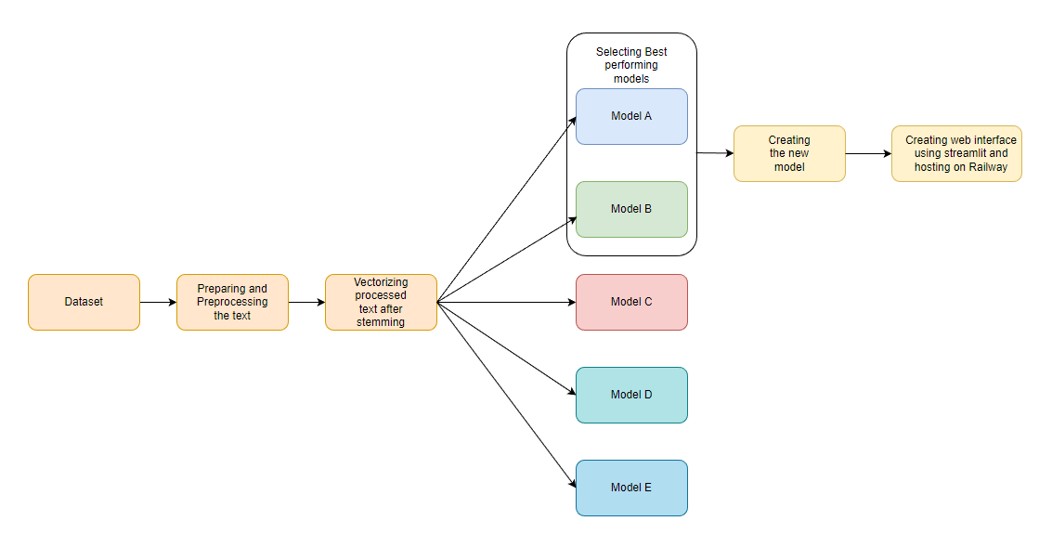
Architecture

Slide 14
Proposed modules
Natural Language Toolkit (nltk):
Using nltk library we will extract features of the text messages such as number of words, letters and sentences and use the nltk library to remove the stopwords using nltk corpus and then stem the text using Porter Stemmer.
Term Frequency-Inverse Document Frequency vectorizer(tf-idf):
Using bag of words strategy to a word presence feature set from all of an instance's words,the terms with the highest frequency become dominant in the data we will use Tf-Idf as the vectorizer, performed by multiplying the number of times a word appears in a document (Term-Frequency-TF) by the term’s inverse document frequency (Inverse-Document Frequency-IDF) across a collection of documents. These scores can be used to highlight unique terms in a document or words that indicate crucial information.

